Slide 1

Diversity in Teams
Team 5
Stephanie Dominguez Andrade
Sidharth Bhutani
Kuan-Chieh Chen
Oluwabusayo Praise Soetan
Ngoc Ha Vu

Slide 2

Introduction
Problems solved within a multicultural team leads people to consider themselves better teammates.

Slide 3





Caveats
Sample size of 40 respondents (Hult students)
Faulty speech to text software
Survey was limited to 6 questions
Not representative and significant
Logarithmic Curve
Notes:
Looking at our logarithmic curve, we can see that the each individual word count is extremely random and does not follow a proper logarithmic curve.
According to Zipf's Law, the frequency of any word is inversely proportional to its rank in the frequency table. This means that the most frequent word will occur twice as often as the second, and so on.
Since our logarithmic graph did not look similar to Zipf's, it means that we do not have good enough quality data to use for our model.

Slide 4
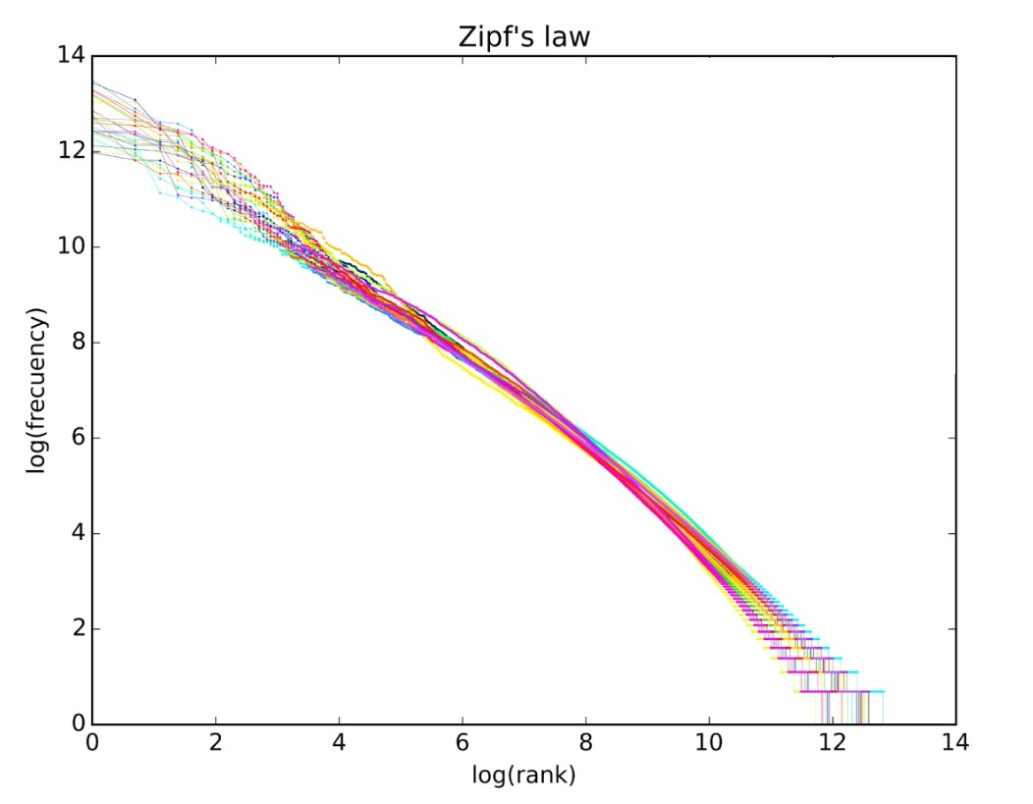
Ideal Zipf’s Curve

Slide 5
Conclusion
Confirmed hypothesis
Most people believed that they are good teammates
Eliminate limitations
Larger sample size and better constructed questions
Repetition of the project

Slide 6
References
http://www.exactlywhatistime.com/other-aspects-of-time/time-in-different-cultures/
https://hbr.org/2016/05/different-cultures-see-deadlines-differently
https://www.thebalancecareers.com/communication-skills-list-2063779
https://leadershipchoice.com/power-good-communication-workplace/
https://hbr.org/2016/01/how-to-boost-your-teams-productivity
http://publica.fraunhofer.de/eprints/urn_nbn_de_0011-n-3827082.pdf
https://core.ac.uk/download/pdf/38093915.pdf
https://core.ac.uk/download/phttps://nlp.stanford.edu/IR-book/html/htmledition/zipfs-law-modeling-the-distribution-of-terms-1.htmldf/38093915.pdf

